Slide 1
Topological Sort Algorithm

Slide 2
Applications of Graphs: Topological Sorting
Topological order
  A list of vertices in a directed graph without cycles such that vertex x precedes vertex y if there is a directed edge from x to y in the graph
  There may be several topological orders in a given graph
Topological sorting
  Arranging the vertices into a topological order

Slide 3
Topological Sort
Directed graph G.
Rule: if there is an edge u → v, then u must come before v.
Ex:
A
B
G
F
C
I
H
A
B
E
D
G
F
C
I
H
E
D

Slide 4
Intuition
Cycles make topological sort impossible.
Select any node with no in-edges
  print it
  delete it
  and delete all the edges leaving it
Repeat
What if there are some nodes left over?
Implementation? Efficiency?

Slide 5
Implementation
Start with a list of nodes with in-degree = 0
Select any edge from list
  mark as deleted
  mark all outgoing edges as deleted
  update in-degree of the destinations of those edges
    If any drops below zero, add to the list
Running time?

Slide 6
Implementation
Start with a list of nodes with in-degree = 0
Select any edge from list
  mark as deleted
  mark all outgoing edges as deleted
  update in-degree of the destinations of those edges
    If any drops to zero, add to the list
Running time? In all, algorithm does work:
  O(|V|) to construct initial list
  Every edge marked “deleted” at most once: O(|E|) total
  Every node marked “deleted” at most once: O(|V|) total
  So linear time overall (in |E| and |V|)

Slide 7
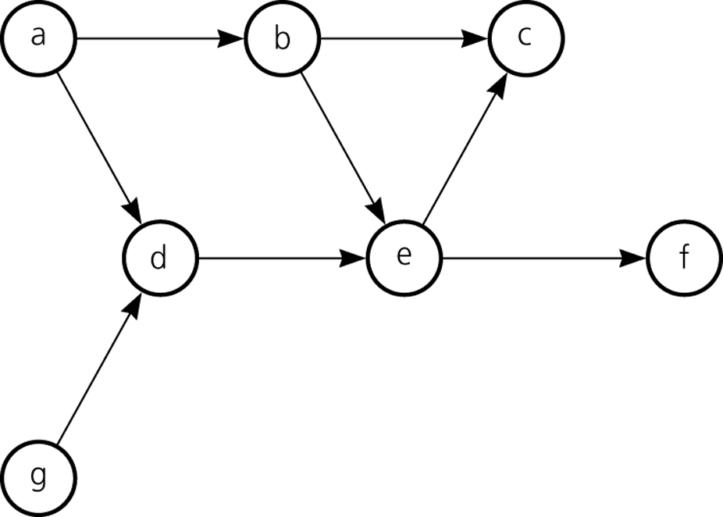
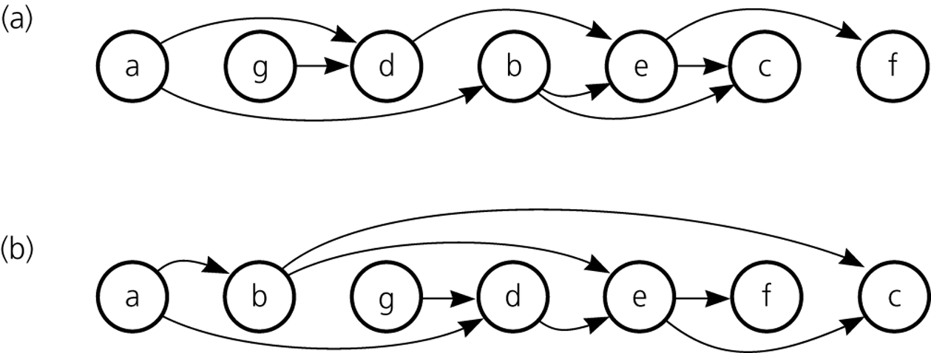
Topological Sorting
Figure 13.14
A directed graph without cycles
Figure 13.15
The graph in Figure 13-14 arranged according to the topological orders a) a, g, d, b, e, c, f and b) a, b, g, d, e, f, c

Slide 8
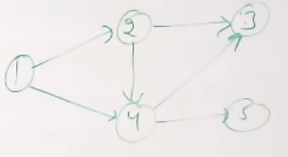
Example DAG

Slide 9
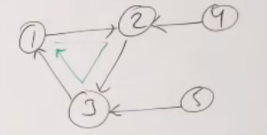
Example Cyclic Graph

Slide 10
Topological sort
How to topological sort a dag?
Just use DFS_Traversal
The reverse order of DFS_Traversal is a topological sorted order

Slide 11
Why should we care?
Shortest path problem in directed, acyclic graph
  Called a DAG for short
General problem:
  Given a DAG input G with weights on edges
  Find shortest paths from source A to every other vertex

